Slide 1
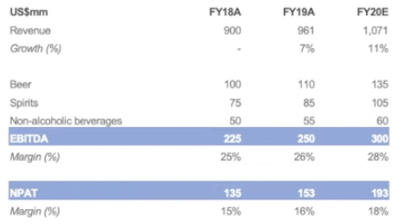
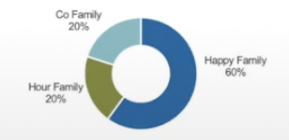
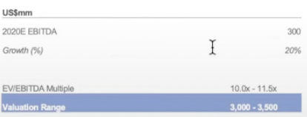
HappyHour Co. Company Profile
Leading beer producer, spirits, and non-alcoholic beverages in Singapore and Malaysia.
Overview
Key financials
Producer of beer, spirits, and non-alcoholic beverages based in Asia.
Operations: manufacturing, distribution, and direct sales in Singapore (HQ), Malaysia (manufacturing in Malaysia is outsourced to Brew Co.), and China.
Majority Owner and co-founder due to looking to exit with no close family to inherit the business.
Strengths:
Largest Beer and Spirits company in Singapore & Malaysia.
Largest non-alcoholic beverages in Malaysia.
Developed a strong supply chain with strong relationship with distribution.
Shareholders
Indicative valuation
Source: Notes on HappyHour Co. v3
1

Slide 2
Overview of auction process and key workstreams
 | Date | Event | Key workstreams
Round 1: Indicative Bid Phase | Mar 9, 2020 | Access to Indicative Bid Documents | Valuation: Initial valuation analysis based on indicative bid documents Structure and financing: Begin financial discussion Approvals: Collect and confirm required approvals
 | 9am Apr 9, 2020 – 5pm Apr 13, 2020 (HKT) | Indicative Bid Q&A Submissions Due
 | 5pm May 13, 2020 (HKT) | Indicative Bid Due
Round 2: Final Bid Phase | Late May 2020 | Start of Final Bid Phase Release of Process Letter Two | Site visit & management presentations: Organize site visit and presentation Due diligence: Conduct due diligence based on new information collected Organize Q&A submission. Valuation: Finalize valuation based on the financial forecasts Financing: Confirm sources Approvals: Commence preparing application for internal regulatory approvals
 | Late July 2020 | Final Bid
1

